Slide 1

Physiological parameters of Well-being
Role of the Cardio-vascular system

Slide 2
Maintaining brain health and plasticity throughout life is an important public health goal, and it is increasingly clear that exercise can help us to achieve it

Slide 3
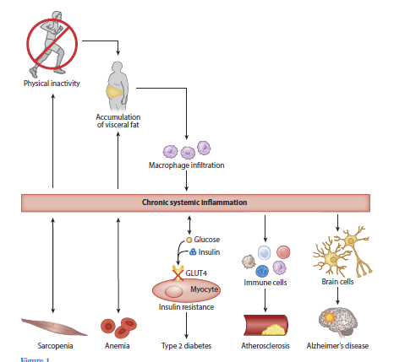
The links between the lack of physical activity, abdominal adiposity, inflammation, and disease
Pedersen, 2018, Annual Review of Physio

Slide 4
Recent literature
Physical activity is associated with a range of health benefits, and its absence can have harmful effects on health and well being, increasing the risk for coronary heart disease, diabetes, certain cancers, obesity, hypertension and all cause mortality (CDC 1996)
Physical inactivity may also be associated with the development of mental disorders: some clinical and epidemiological studies have shown associations between physical activity and symptoms of depression and anxiety in cross-sectional and prospective-longitudinal studies (Goodwin 2003; Motl et al. 2004)
Exercise is an integral part in the treatment and rehabilitation of many medical conditions. Improving physical well being may also lead to improved psychological well being and is generally accepted that physical activity may have positive effects on mood and anxiety

Slide 6

Exercise and neurotrophic factors
Exercise is a simple behavior that activates molecular and cellular cascades that support and maintain brain plasticity
It induces expression of genes associated with plasticity, such as that encoding BDNF, and in addition promotes brain vascularization, neurogenesis, functional changes in neuronal structure and neuronal resistance to injury
Significantly, these effects occur in the hippocampus, a brain region central to learning and memory
Some of the beneficial aspects of exercise act directly on the molecular machinery of the brain itself, rather than on general health
Physical condition has been positively related to school achievement of children and college students (Gruber, 1975),
Improvement in physical condition associated with improvement in cognitive functioning on global measures of mental functioning (Cattell Culture Fair Intelligence Test)

Slide 7
Exercise and the brain
Cardiovascular exercise make you smarter
Heart-pumping activity is also an instant mood booster and has been shown to be as effective as prescription antidepressant medicine. Exercise activates the same pathways in the brain as morphine and increases the release of endorphins, natural feel-good neurotransmitters Cardio allows natural mood-enhancing amino acid tryptophan to enter the brain
Tryptophan is a precursor to the neurotransmitter serotonin, which balances moods
It is a relatively small amino acid, and it often competes with larger amino acids to cross the blood channels into the brain. With exercise, the muscles of the body utilize the larger amino acids and decrease the competition for tryptophan to enter the brain, which makes you feel better

Slide 8

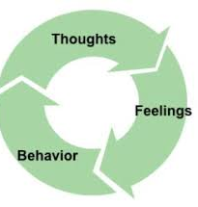
What are the mental health benefits of exercise?
Research indicates that modest amounts of exercise can make a real difference. No matter your age or fitness level, you can learn to use exercise as a powerful tool to deal with mental health problems, improve your energy and outlook, and get more out of life
Exercise and depression - Harvard T.H. Chan School of Public Health found that running for 15 minutes a day or walking for an hour reduces the risk of major depression by 26%. In addition to relieving depression symptoms, research also shows that maintaining an exercise schedule can prevent you from relapsing
Cardio exercise produces endorphins that may improve your sense of well-being and overall mood
Cardio can increase neurotransmitters like glutamate, GABA, serotonin, and norepinephrine, which may be low in depressed people
Exercise improves sleep. Going outside, changing routine, and social interaction helps mood elevation
Exercise and anxiety - It relieves tension and stress, boosts physical and mental energy, and enhances well-being through the release of endorphins
Teens who engage in physical fitness can reduce the risk of depression and suicide later in life, and even exercise as simple as walking can reduce overall symptoms of depression

Slide 9
What are the mental health benefits of exercise?
Exercise and stress – stress contracts muscles inducing back or neck pain, or painful headaches, tightness in your chest, a pounding pulse, or muscle cramps, with added problems of insomnia, heartburn, stomachache, diarrhea, or frequent urination. The worry and discomfort of all these physical symptoms can in turn lead to even more stress, creating a vicious cycle between your mind and body
Exercising is an effective way to break this cycle. As well as releasing endorphins in the brain, physical activity helps to relax the muscles and relieve tension in the body. Since the body and mind are so closely linked, when your body feels better so, too, will your mind.
Exercise and ADHD - Exercising regularly is one of the easiest and most effective ways to reduce the symptoms of ADHD and improve concentration, motivation, memory, and mood. Physical activity immediately boosts the brain’s dopamine, norepinephrine, and serotonin levels—all of which affect focus and attention. In this way, exercise works in much the same way as ADHD medications such as Ritalin and Adderall
Other mental health benefits of exercise
Sharper memory and thinking
Higher self-esteem
Better sleep
More energy
Stronger resilience

Slide 10
If exercise makes us feel so good, why is it so hard to do it?
Starting out too hard in a new exercise program may be one of the reasons people disdain physical activity
When people exercise above their respiratory threshold — that is, above the point when it gets hard to talk — they postpone exercise's immediate mood boost by about 30 minutes
For novices, that delay could turn them off from the treadmill for good.
Sports trainers suggest workout neophytes start slowly, with a moderate exercise plan
An emphasis on the physical effects of exercise also brings about apathy to activity. Physicians frequently tell patients to work out to lose weight, lower cholesterol or prevent diabetes. Unfortunately, it takes months before any physical results of your hard work in the gym are apparent
Getting started with exercise
Start small
Schedule workouts when your energy is highest
Focus on activities you enjoy
Be comfortable
Reward yourself
Make exercise a social activity
The exercise mood boost, offers near-instant gratification

Slide 11

Designing a therapeutic exercise program
A program may include exercise for improving or preventing deterioration in:
aerobic capacity
muscle strength power and endurance
flexibility or range of movement
balance, coordination, and agility
All exercise training and sport sessions should start with a 10–15-min dynamic warm-up period followed by 20–60 min of exercise training
Finally, a 10-min cool-down period with less intensive activities and stretching should end the exercise training session
Between the training sessions, there must be enough time to recover

Slide 12
Common training principles of exercise
Overload
A system must be exercised at a level beyond which it is presently accustomed for a training effect to occur
The system being exercised will gradually adapt to the overload or training stimulus being applied, and this will go on happening till the training stimulus continues to be increased until the tissue can no longer adapt
The training stimulus applied consists of different variables such as intensity, duration, and frequency of exercise
It is important to give the system being exercised enough time to recover and only apply a training stimulus again when the system is no longer fatigued (warm up and cool down)
Specificity
Any exercise will train a system for the particular task being carried out as the training stimulus. Eg: a training program including muscle strengthening will train the muscle in the range that it is working and the way that the muscle is being used, i.e. isometrically, concentrically, or eccentrically
It is important that any exercise to strengthen muscle targets the muscle range and type of muscle work specific to the task required. Eg: riding a bicycle requires concentric knee extension from mid-to inner range, as the pedal is pushed down to propel the bicycle along. Cyclist wishing to increase the strength of his quadriceps will need to train concentrically in mid-to inner range
Depending on the presenting problem, the required task should become part of the training program at an appropriate stage

Slide 13
Common training principles of exercise
Reversibility
Individuality
The beneficial effects of training begin to be lost as soon as training stops. This happens in a similar time frame as it takes to train the system
Variation in response to a training program will occur in a population as people respond differently to the same training program. This depends on the initial fitness level of the individual, their health status, and their genetic makeup
Those individuals with a lower fitness level before starting an exercise program show improvement in fitness more quickly than those who are relatively fit before training begins
Some individuals with health conditions may not be able to work at the same kind of intensity as a healthy individual and so will take longer to achieve a training goal
Safety
Whenever an individual exercise, there is a risk that they may injure themselves. Safety factors are considered here in relation to the physiotherapist. the environment and the patient or person carrying alit the exercise^{[4]}.

Slide 14
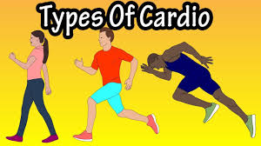

What is meant by Cardiovascular exercise?
Cardiovascular fitness relates to the body’s ability to generate energy and deliver oxygen to working muscles
These types of exercises sustain oxygen to the muscles for an extended time period
The most important component of physical fitness and the best indicator of overall health
Aerobic exercises are best for developing cardiovascular fitness
Aerobic means “with oxygen” and includes continuous activities that use oxygen
Examples: walking, biking, jogging, skating

Slide 15
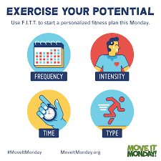
Aerobic (cardiorespiratory endurance)capacity
The dose of exercise can be described using the so-called FITT factors, where FITT stands for Frequency, Intensity, Time, and Type of activity
The same principle could be used endurance training to dose a load
Some individuals may not respond as expected because of individual variability in the magnitude of response to a particular exercise regimen
Furthermore, the FITT principle of exercise may not apply in certain cases because of individual characteristics (e.g., health status, physical ability, age) or athletic and performance goals
Accommodations to the exercise should be made for individuals with clinical conditions and healthy individuals with special considerations
ACSM recommends to use the FITT method

Slide 16
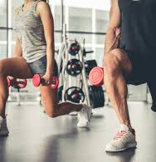
Frequency -2-3 days a week
Intensity -one set of 8-10 RM (Repetition Maximum) to volitional fatigue
Duration -3 seconds for the concentric phase and 3 seconds for the eccentric phase of the activity (about 1 minute in total)
A general strengthening program would include 8-10 exercises that target all the major muscle groups in the body
Resistance training (RT) is an effective method to improve muscular strength, power, and hypertrophy which are fundamental components of physical fitness related to the quality of life
STRENGTH TRAINING

Slide 17
A repetition maximum (RM) is the most weight you can lift for a defined number of exercise movements. For example, a 10RM would be the heaviest weight you could lift for 10 consecutive exercise repetitions. Your RM is a good measure of your current strength level1﻿ as you follow your weight training program
Volitional fatigue is achieved during a set of repetitions (in exercise) when the muscle can no longer perform the action to perfect form. You will feel lapses in the smoothness or find yourself having to “cheat” to finish repetitions beyond the point of volitional fatigue

Slide 18
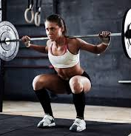
Research over the last few decades –
the effects of several acute training variables on maximal strength gains that influence the overall outcome of an RT program
These variables include exercise order, the number of sets, repetitions, inter-set recovery periods, training intensity per muscle group, and total training volume

Slide 20
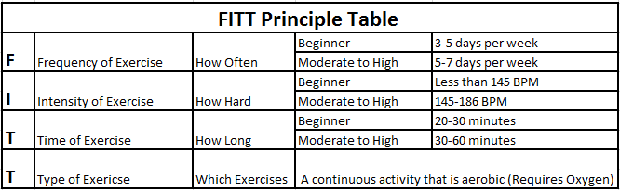
The physiology behind it….
Aerobic activities strengthen the lungs and heart and make the working muscles more efficient at using oxygen
They also increase stroke volume (amount of blood pumped per heartbeat) and lowers the resting heart rate
Increasing stroke volume is means that the heart does not have to work as hard
A resting heart rate varies from person to person, however the lower your resting heart rate, the more efficient your heart is working
One long-term result of regular aerobic activity: Increase in cardiovascular endurance, or cardio-respiratory endurance -The ability of the body to work continuously for extended periods of time
Those who have a high level of cardiovascular fitness have lowered risks of adult lifestyle diseases, such as, type 2 diabetes, cardiovascular disease, and obesity
Cardiovascular endurance increases chances for living a longer and healthier life. It is important to know your FITT Principles so that you gain health benefits for your heart. The table below illustrates the different FITT Principles

Slide 21
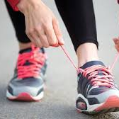
FITT PRINCIPLES
Frequency of Exercise: Cardiovascular benefits are achieved when you engage in exercise 3-5 times each week. You may gain additional benefits if you engage in an activity more frequently, but 3-5 times is the recommended range to improve general fitness
Intensity of Exercise: Intensity refers to how hard you are working. Intensity is one of the most important ways to determine if you are exercising at a level that benefits your heart. This level is called your Target Heart Rate (THR) Zone. In general, this means exercising at a level where the heart is beating between 50% and 85% of a person’s maximum heart rate (220 minus age) or approximately 142–186 BPM (average for youth)
Time (Duration) of Exercise: Time refers to how long you should exercise in your Target Heart Rate Zone. To achieve the greatest cardiovascular benefit, a workout should be at least 20 minutes of continuous or intermittent aerobic activity per exercise session. Intermittent means that the activity should be done in blocks of time that are 10 minutes or longer. Cardiovascular benefits continue to increase as the exercise duration is extended to 60 minutes. Beyond 60 minutes of activity, cardiovascular benefits start to level off, and the risk of injury increases
Type of Exercise: Types of cardiovascular fitness exercises include rhythmical, repetitive activities that involve large muscle groups and are performed over prolonged periods. These types of activities provide the greatest improvements in cardiovascular fitness. The list of activities that fall into this category include walking, cycling, swimming, jogging, and aerobic class type activities.

Slide 22
Heart Rate Percentages
Age | MHR | 50% | 60% | 70% | 80% | 90%
11 | 209 | 147 | 160 | 172 | 185 | 197
12 | 208 | 146 | 159 | 171 | 183 | 196
13 | 207 | 146 | 158 | 170 | 182 | 194
14 | 206 | 146 | 158 | 170 | 182 | 194
15 | 205 | 139 | 152 | 165 | 178 | 192
16 | 204 | 138 | 151 | 164 | 178 | 191
17 | 203 | 138 | 151 | 164 | 177 | 190
18 | 202 | 137 | 150 | 163 | 176 | 190

Slide 23
How fit are you? See how you measure up
Generally, fitness is assessed in four key areas: aerobic fitness; muscular strength and endurance; flexibility; and body composition
To do your assessment, you'll need:
A stopwatch or a watch that can measure seconds
A cloth measuring tape
A yardstick
Heavy-duty tape
A scale
Someone to help you record your scores and count repetitions
You'll also need a pencil or pen and paper to record your scores as you complete each part of the assessment. You can record your scores in a notebook or journal, or save them in a spreadsheet or another electronic format

Slide 24
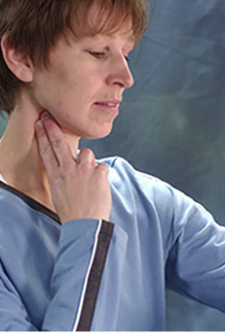
Aerobic fitness: Heart rate at rest
Your heart rate at rest is a measure of heart health and fitness. For most adults, a healthy heart rate is 60 to 100 beats a minute
To check your pulse over your carotid artery, place your index and middle fingers on your neck to the side of your windpipe
To check your pulse at your wrist, place two fingers between the bone and the tendon over your radial artery, located on the palm side of your wrist below the thumb.
When you feel your pulse, look at your watch and count the number of beats in 15 seconds. Multiply this number by 4 to get your heart rate per minute. Let's say you count 20 beats in 15 seconds. Multiply 20 by 4 for a total of 80 beats a minute

Slide 25
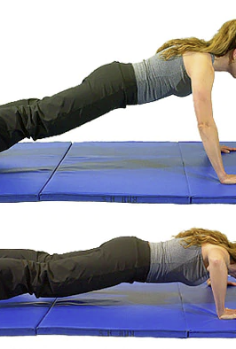
Measuring muscular fitness
Muscular strength and endurance: Pushup test
Pushups can help you measure muscular strength and endurance. If you're just starting a fitness program, do modified pushups on your knees. If you're generally fit and able to do them, do classic pushups. Follow these steps for both types:
Lie facedown on the floor with your elbows bent and your palms next to your shoulders.
Keeping your back straight, push up with your arms until your arms are extended.
Lower your body until your chin touches the floor.
Do as many pushups as you can until you need to stop for rest

Slide 26
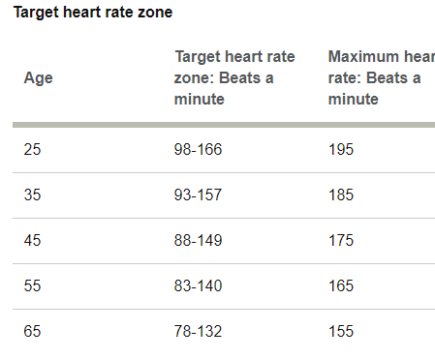
Aerobic fitness: Target heart rate zone
The target heart rate zone is an increase in your heart rate — 50% to 85% of the maximum heart rate for your age — great enough to give your heart and lungs a good workout
Aim for 50% to 70% when you do moderately intense activities and 70% to 85% when you do vigorous activities
You can use the target heart rate zone as a guide for making sure your exercise is intense enough. If you're not reaching your target zone, you may need to increase the intensity. If you're achieving a target rate in the lower end of the target rate zone, you can set goals for gradually increasing your target
If you already exercise regularly, you can stop to check your heart rate sometimes during an aerobic workout. If you don't exercise regularly, you can do a simple test by checking your heart rate after a brisk 10-minute walk or static jump for 30 times

Slide 27
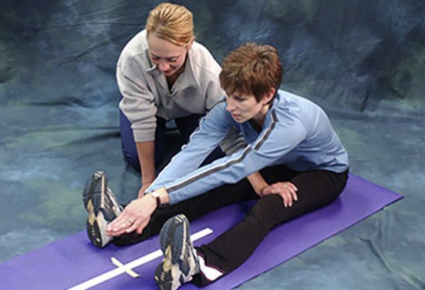
Flexibility: Sit-and-reach test
How far can you reach?
The sit-and-reach test is a simple way to measure the flexibility of the back of your legs, your hips and your lower back
Place a yardstick on the floor. Secure it by placing a piece of tape across the yardstick at the 15-inch (38-centimeter) mark
Place the soles of your feet even with the 15-inch (38-centimeter) mark on the yardstick
Slowly reach forward as far as you can, exhaling as you reach and holding the position for at least 1 second
Note the distance you reached
Repeat the test two more times
Record the best of the three reaches

Slide 28
How fit are you mentally?

